Slide 1

WA-FER Agri Drone
PROJECT COORDINATOR:-
MR. Vivek kumar gupta
Under the supervision of:-
Mr. Saurabh mishra
By:-
SHYVANSHU MEHRA
KUSH GAUR
SAMARPIT BURMAN
(ECE Iv YEAR)

Slide 2
CONTENTS
Introduction
Hardware Components
Software Components
Flowchart Of Making
Ground Station
Circuit Diagram
Code
Advantages And Disadvantages
Final Result

Slide 3
Introduction
In India, Agriculture is a major sector of our economy but it is still very short western countries when it comes to adaptability the latest technology for better farm production.
Farmers in developed countries have already begun using installed agricultural drones to improve the plant process treatment.
The Hexa-copter, is basically a helicopter with 6 rotors instead of 2 used in a standard helicopter. Hexa-copters have gained great popularity in the field of Unmanned Autonomous Vehicle (UAV) research. " 1/6 weight so that we can use cheap engines.
Also, Hexa-copter is easy to build and control and because of their size, they can carry a good amount of load from one place to another.

Slide 4
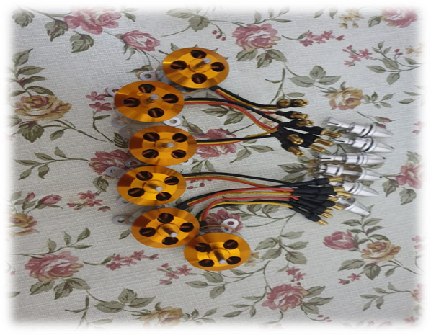
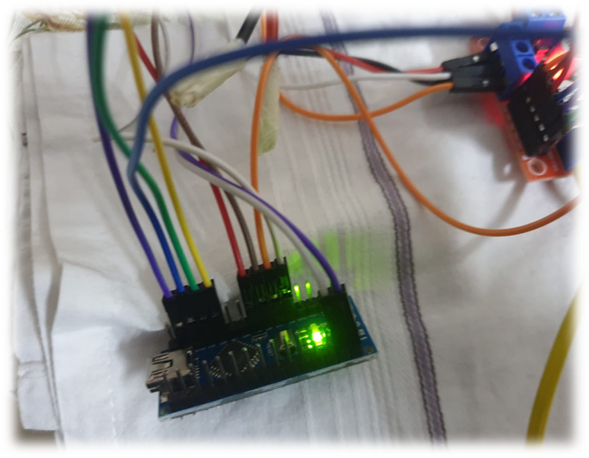
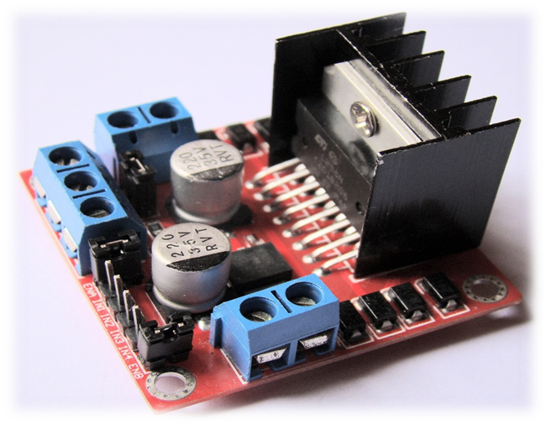
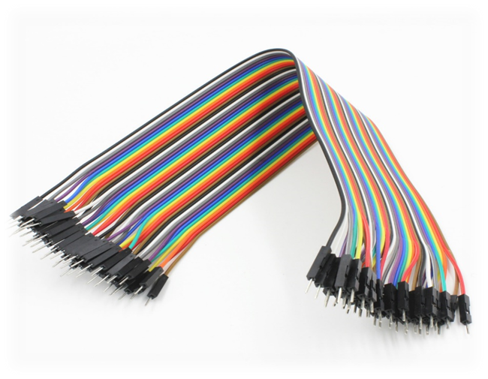
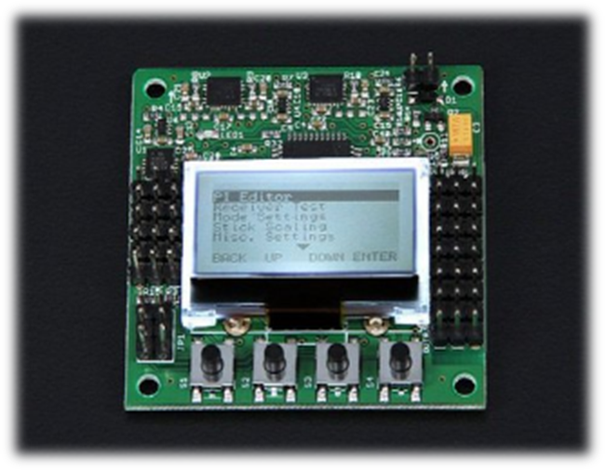
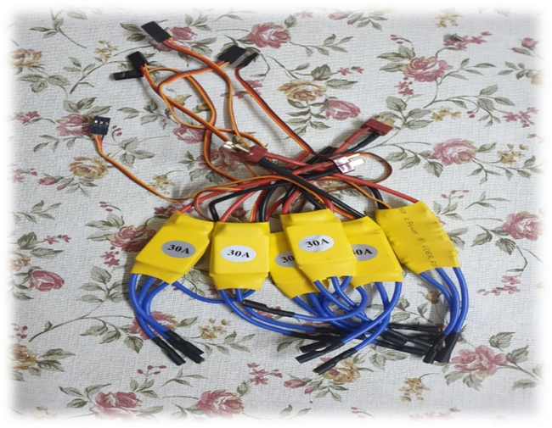
Hardware Components
BLDC motors
ESC
Arduino Nano
L98N motor driver
Connecting Wires
KK 2.1.5 Flight Controller
Transmitter And Receiver
Li-Po Battery/ 9V Battery
Breadboard
Buzzer/LED
Arduino Uno

Slide 5

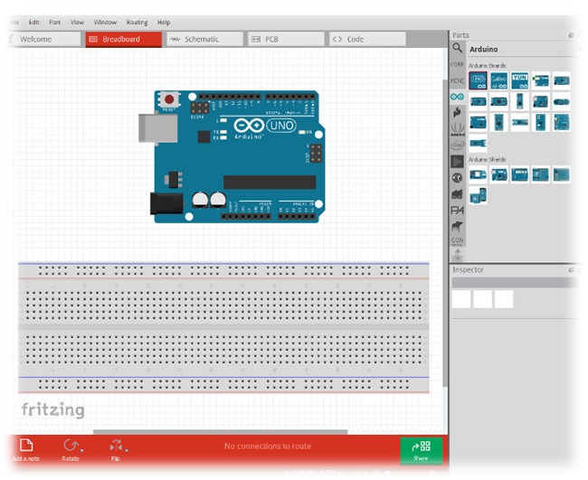
Software Components
Arduino IDE
Fritzing Software

Slide 6
Ground Station
The Ground station consists of Arduino board, moisture sensor, LED, buzzer and a battery or power source. The moisture sensor, LED and buzzer will be connected to the Arduino board with the help of connecting wires.
Construction
LED positive is connected to pin 13 of the Arduino and the negative to the ground. Buzzer positive is connected to the pin 12 of the Arduino and negative to the ground.
Output of moisture sensor is connected to the Analog pin A0 of the Arduino and Vcc is connected to 5v pin of the Arduino, and ground to the ground of Arduino. The Arduino is powered by a 9v battery

Slide 7
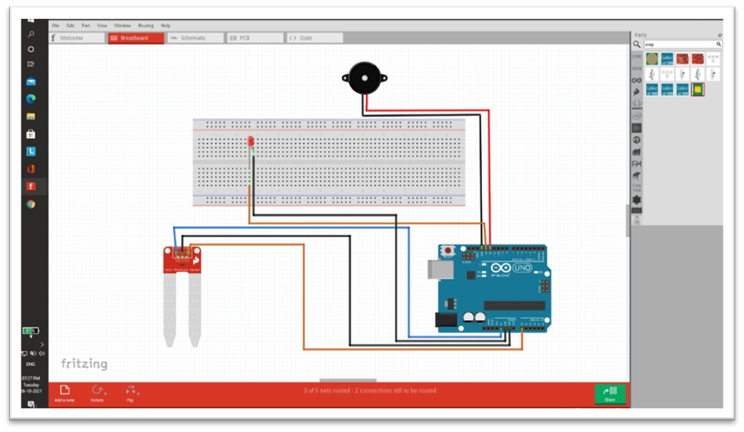
Circuit Diagram

Slide 8
Code
void setup () {
Serial.begin(9600);
pinMode(A0, INPUT);
pinMode(13, OUTPUT);
pinMode(12, OUTPUT);
}
void loop () {
int val = analogRead(A0);
Serial.println(val);

Slide 9
Code Continue
if (val < 800) {
digitalWrite(12, HIGH);
digitalWrite(13, LOW);
}
if (val > 1000) {
digitalWrite(13, LOW);
digitalWrite(12, HIGH);
}
}

Slide 10
Advantages And Disadvantages
Advantages
Drones are used in large-scale farming to spray water and pesticides because of their remote-control performance.
Helps to monitor environmental data that helps in smart farming if mounted with camera.
Helps farmers to inspect their fields quickly and effectively.
It is easy to use them with basic training.

Slide 11
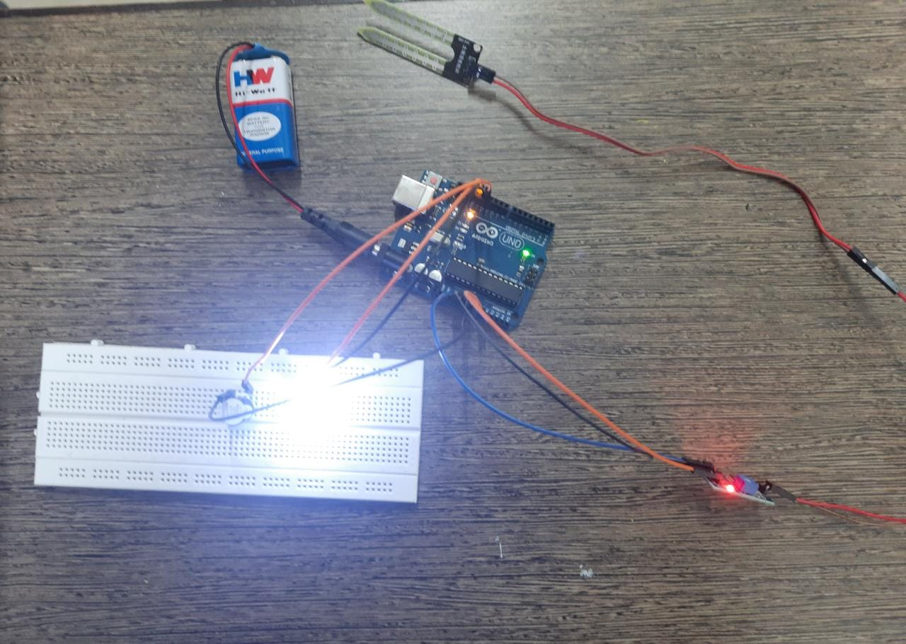
Final Result (Ground Station)

Slide 12
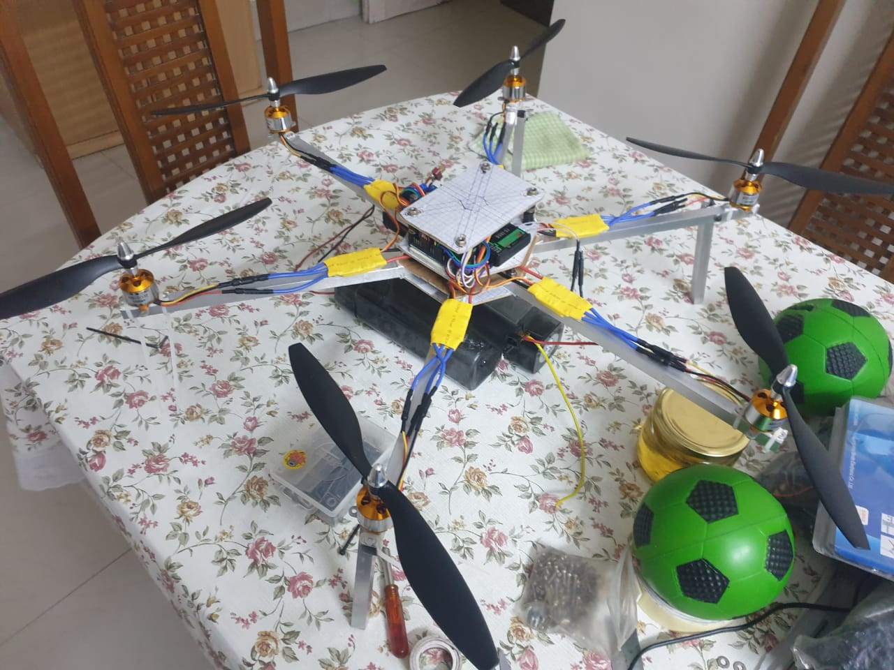
Final Result (WA-FER Agri Drone)

Slide 13
THANKYOU

